Slide 1
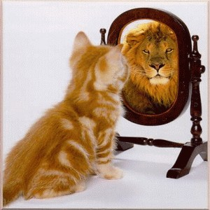
Advocating a more positive body image
Love the Skin You’re In

Slide 2
Cross the Line IF…
…appearance is the first thing that you notice about someone?
…you care what others think of what you wear
…your image is very important to you
…magazine articles/ads make you feel a certain way about your own body

Slide 3
What is Body Image?
How you think, feel, and perceive your physical appearance to be
Physical
Emotions
Mood
Imagination
Mental
Perception

Slide 4
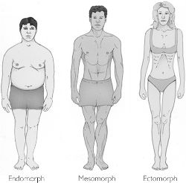
Which Body Type Are You?

Slide 5
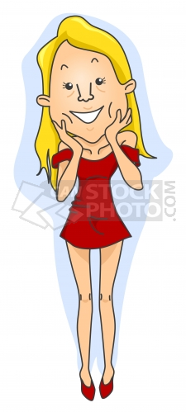
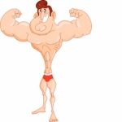
Male Vs. Female Stereotypes
Thin
Tall
Large boobs
Nice butt
Tan
Great hair
Tall
Muscular
Athletic build
6-pack
Chiseled
“macho”

Slide 6
Teen Truth: Body Image http://www.youtube.com/watch?v=PpFBKeuKf7M

Slide 7
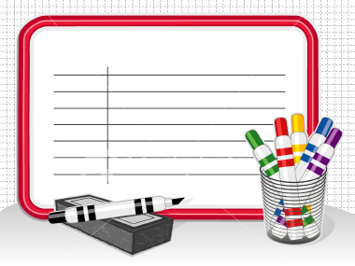
Whiteboard Q&A

Slide 8
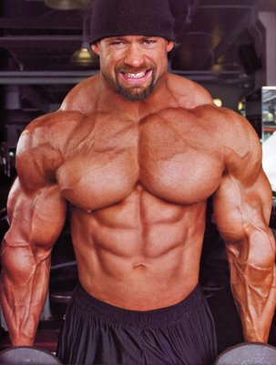
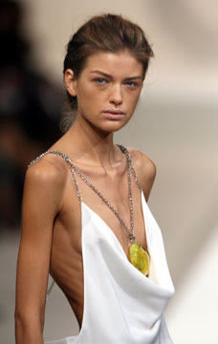
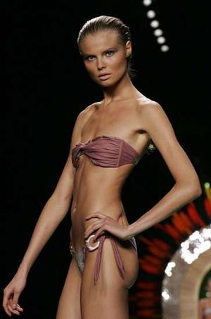
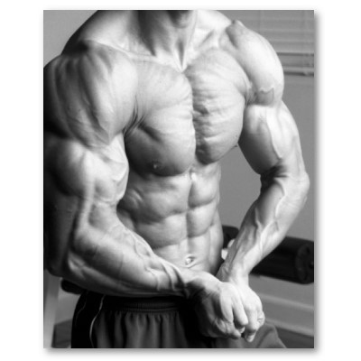
Realistic?

Slide 9
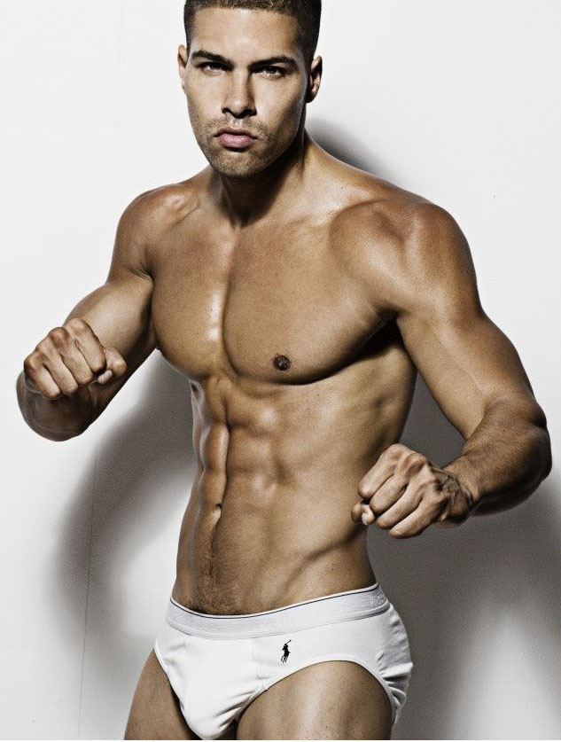
Realistic?

Slide 10
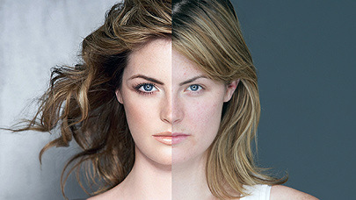
Dove Evolution Commercial
http://www.youtube.com/watch?v=hibyAJOSW8U&feature=related

Slide 11
What is Advocacy?

Slide 12
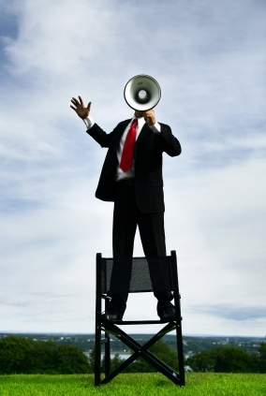
Advocacy
Take a stand
What is important to you?
Support your position
Use accurate information
Be assertive
Know your audience
Respect others opinions
Encourage others to make
healthy choices

Slide 13
How to Love Your Body
Attention- listen to your internal cues
Appreciation- enjoy the pleasure your body can provide you
Acceptance- accept what is instead of longing for what is not

Slide 14
What Can You Do to be an Advocate for Yourself?

Slide 15
What You Can Do
Give up dieting and just eat healthy and exercise
Fight size discrimination by speaking positively of others
Focus your thoughts toward the amazing person you are, rather than what you aren’t
Arrange your priorities according to what is most important to you

Slide 16
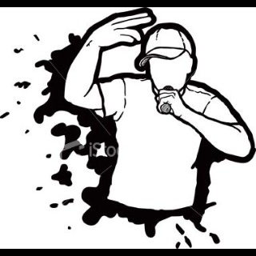
Time to Rap It Up!
Get into groups of
four
Come up with an 8 line rap advocating a positive body image
Include 2 or more facts from the content

