Slide 1
PERSONAL AND CONSUMER HEALTH
JOE SOLLENBERGER
JENNY EDWARDS
ZACH STOBART

Slide 2
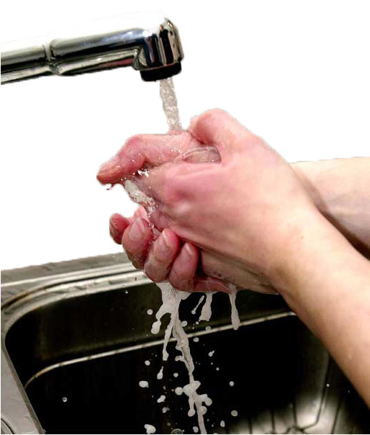
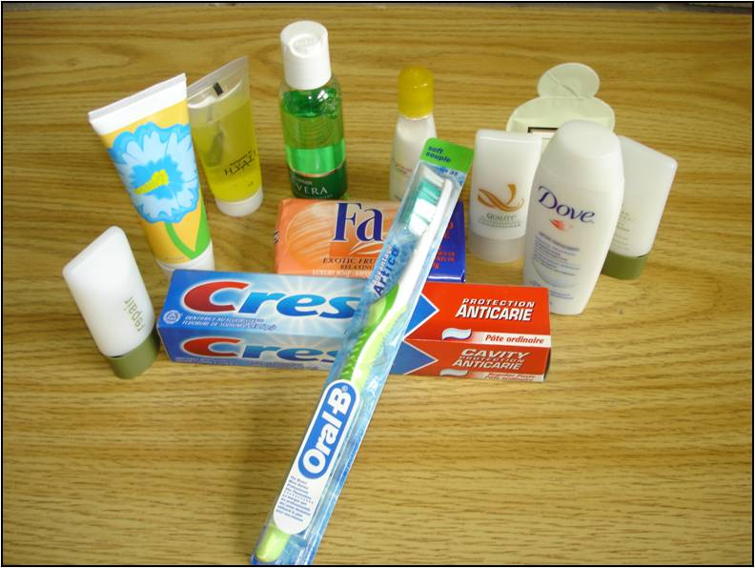
Personal health choices and behaviors play an important role in disease prevention.
Maintaining proper hygiene and dental care also contributes to a healthy lifestyle.
Using and selecting proper and effective health care products and services also contributes to your health.

Slide 3
Personal Health Care
Middle School
Appropriate skin care to prevent/treat acne
Techniques to wash your face: twice a day, warm water, mild soap
Don’t pop pimples, in order to prevent facial scarring and infection
Avoid touching your face with your fingers and other objects that collect dirt and residue

Slide 4
Personal Health Care
Middle School and High School
Benefits of regular dental cleaning/checkups
Important to get a cleaning/checkup every 6 months
Checkups prevent disease and infection of the mouth
Dental checkups can prevent tooth decay
Effective tooth care
How to floss correctly
Lack of flossing can cause plaque to harden between teeth and become tartar
Techniques for brushing teeth

Slide 5
Personal Health Care
Strategies for effective eye/hearing protection
The importance of a healthy diet
Going for regular ear and eye exams
Wearing sunglasses blocks harmful UV rays
High School

Slide 6
Instructional Strategy: Demonstration
What is it?
Understanding concepts through visual experience
Offers instruction in an exciting and imaginative way
How is it used?
Students are shown how to do something through visual learning
A detailed step-by-step process is outlined

Slide 7
Instructional Strategy: Demonstration
Advantages:
Utilizes several senses
Visually stimulating
Can be showcased by teachers, students, and guest speakers
Provides direct experiences
Disadvantages:
Requires pre-preparation
May limit audience input/participation
May fail
Notes:
Demonstrations....
Utilize several senses; students can see, hear, and possibly experience an actual event

Slide 8
Instructional Strategy: Demonstration
Suggestions for use:
Use when teaching concepts and problem-solving procedures
Can be used at any grade level
Make sure it is time efficient

Slide 9
Instructional Strategy: Demonstration
Materials:
Includes anything that will be used for the demonstration
Management:
Arrange class so that all students can see

Slide 10
Demonstration:
How to Floss Your Teeth

Slide 11
Preventing Disease and Infection
Middle School
The importance of wearing protective clothing
Correct seasonal clothing
Importance of clean clothing
Proper sports attire
The importance of wearing sunscreen
Prevention of UV damage
Prevention of skin cancer/disease

Slide 12
Preventing Disease and Infection
Middle School and High School
Importance of Immunizations
Helps prevent disease and illness
Helps protect the health of a community
Protects individual from others who haven’t been vaccinated
Effective ways to manage disease
Diabetes
Type 1 vs. Type 2
Asthma
Proper medication
Allergies

Slide 13
Preventing Disease and Infection
High School
Prevention strategies associated with primary health care
Testicular self-exam
Pap smear
Roles of genetics and family history of disease
Diseases that run in families
Heart disease, high blood pressure, etc.

Slide 14
Instructional Strategy: Cross the Line
What is it?
Strategy that combines reflection with movement
It encourages the class to move and think while they are doing so
How is it used?
A line is designated on the floor, by using poly spots, tape, or chalk
A statement is then read by the instructor, starting with “Cross the line if…”
These sentences can be content area based, opinions, or even feelings

Slide 15
Instructional Strategy: Cross the Line
Disadvantages:
Lack of classroom space
May not be an accurate form of assessment
Advantages:
Actively engaged
Students process their thoughts to make decisions
Simple activity, little talking
Gives opportunity for students to reflect upon their self-identity

Slide 16
Instructional Strategy: Cross the Line
Suggestions for use:
Appropriate for all ages
Can be used to assess student opinions and ideas
Assessment to see if students are practicing learned skills

Slide 17
Selecting and Using Health Care Products
How to use prescribed and OTC meds appropriately
Abuse of prescribed and OTC drugs
Selecting the correct OTC medication
Information about common dietary supplements
Correct dosage information
Middle School

Slide 18
Selecting and Using Health Care Products
Middle School and High School
Similarities/differences of health care products and services
Positive and negative effects of products
Determining reliable health information online
Differences in health care policies
Providers and financing

Slide 19
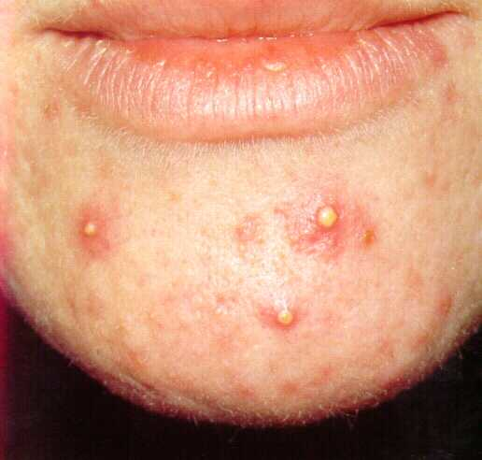
Selecting and Using Health Care Products
How to identify effective acne products
Identifying skin type
Identifying the type of acne
Finding out what works for others
Researching the products
Middle School and High School

Slide 20
Selecting and Using Health Care Products
High School
Options for health care and services for self
School health services
Health insurance plans
Understanding health benefits

Slide 21
Instructional Strategy: Ask a Friend
What is it?
A strategy that allows students to learn through peer assistance
It creates a student-centered environment, rather than a teacher-centered one
Teaches students how to identify and respond to the needs of others
How is it used?
Pupils ask one another for help in understanding a concept or problem rather than relying upon the teacher for answers.

Slide 22
Instructional Strategy: Ask a Friend
Disadvantages:
Students may not stay focused
Students may not know the answers
Advantages:
Helps develop social interaction
Develops problem-solving and critical thinking skills
Allows teacher more time to assess comprehension level of individuals

Slide 23
Instructional Strategy: Ask a Friend
Suggestions for use:
Useful when students are working on problems
When teaching a new concept
Group work
Appropriate in oral questioning situations

Slide 24
Ask a friend…
Senior prom is only a few days away, and you just woke up with one of the worst facial breakouts you’ve ever had!
What is the best way to treat your acne?
What product(s) can you use?
How do you know if that product is the right one for you?

Slide 25
References
CCSSO-SCASS Health Education Assessment Project (2006) Assessment Tools for School Health Education, ToucanEd Inc., Santa Cruz, CA.
Duncan, L.C. and Eckert, C. (2006) Strategies to Inspire Learning-Voices from Experience, Teaching Concepts, Downingtown, PA.
"Health Care System.” Wikipedia, the Free Encyclopedia. Web. Mar. 2011. <http://en.wikipedia.org/wiki/Health_care_system>.
“Steps To Find An Effective Acne Treatment.” Pimple Treatment. Web. Mar. 2011. <http://justpimple.com/31378/steps-to-find-an-effective- acne-treatment/>.
"The Importance of Flossing: Keep Your Mouth Clean! | DentiCenter." Denticenter - High Quality State of the Art Dental Care. Web. Mar. 2011. <http://www.denticenter.com/2011/02/the-importance-of- flossing-keep-your-mouth-clean/>.
"Vaccines: Vac-Gen/Side Effects." Centers for Disease Control and Prevention. Web. Mar. 2011. http://www.cdc.gov/vaccines/vac-gen/side- effects.htm.

